Slide 1

CIS-4951
With Dr. Bruce Maxim
Team 4
Sky Socket (Client Dr. Zheng Song)
Test Plan Specifications
Demetrius Johnson
Ryan Sauer
Olivia Pellegrini
Jonathan Schall

Slide 2

1 Introduction
The testing process for Sky Socket has several goals. The software will be vigorously tested for logic errors and bugs as well as responsiveness and ease of use. The final product should feel approachable and understandable for any user with the appropriate qualifications to research such an area of engineering. Beyond that, we would like our product to feel easier to use than alternatives while providing the dependability and flexibility of said competitors.
Many design specifications will be validated during testing including a simple and easy-to-use interface, accurate and robust file interactions, and a reliable “click and play” UI experience. The GUI should properly interact with the desired devices, locate files accurately, and maintain a reasonable refresh rate and response time.
The manual must be complete enough for even the average user to install and run the entire system. There should also be examples in the form of multimedia (screenshots, etc.) to complement the written instructions. Installation instructions should encompass all aspects necessary in order to use our open-source product. Uninstallation should also completely remove all files installed onto target machines.
Notes:
meech

Slide 3
1 Introduction
Sky Socket has a deadline of August 14th, 2023. This will limit the testing time, especially for such a robust research framework that we envisioned.
The team has 4 developers but only 1 set of hardware for the testing system. All tests will be run on the target hardware, but with limited access time.
This will be mitigated by thorough unit and integration testing on nontarget hardware before high level testing.
Target hardware is expected to be no more than the middle line Raspberry Pi running RaspbianOS.
Sky Socket GUI is expected to run only on Windows 10 machines.
During integration testing or system testing when the drone is actually flying, there is a big risk that the flight mechanism can be damaged due to some known or unknown error or due to faulty hardware that is out of our control; in fact, the drone could be destroyed altogether. We do not have any spare drones, and drone repair time (if even possible) would take up a lot of time, and we would have to do possibly a lot of reinstallations and thus run testing from the very beginning.
To mitigate this, our backup plan would be to use a node that is not really a drone but that can still run most of our components and act as a drone.
Notes:
meech

Slide 4
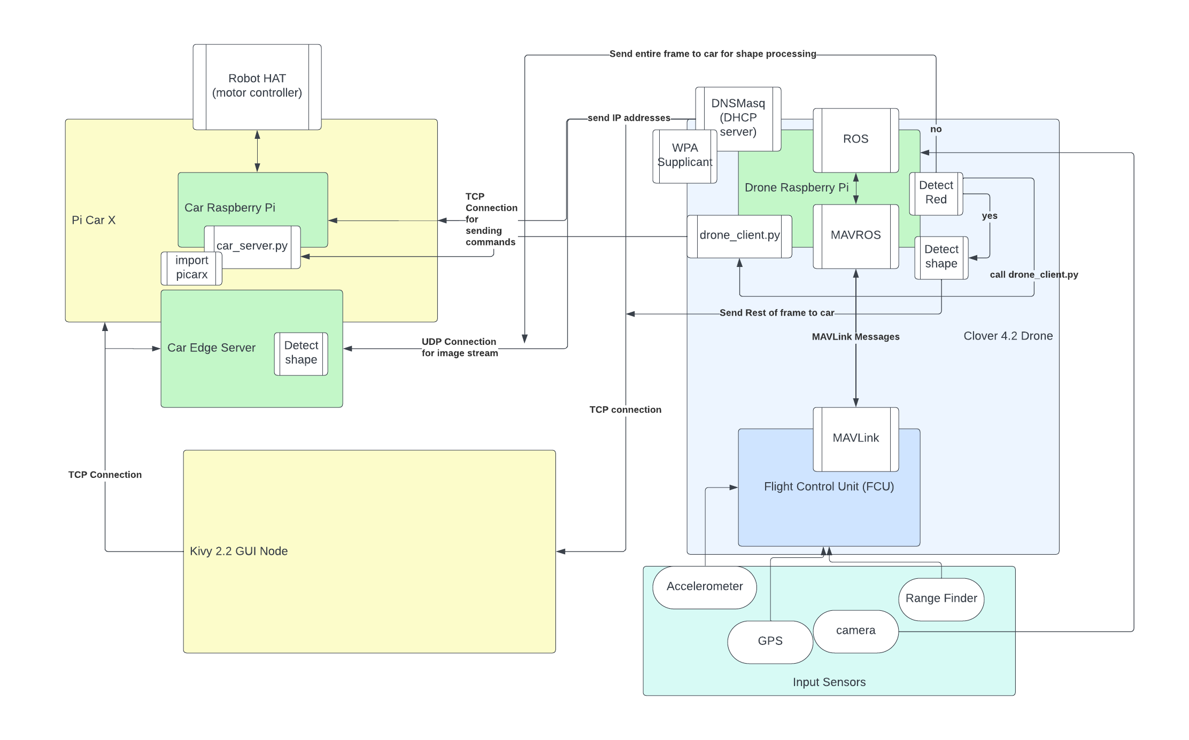
1 Introduction - overview of all components to be tested
Notes:
meech

Slide 5
2 Test Plan: SCIs to be Tested
Graphical User Interface (GUI)
Simulation Tab
Video Player
Terminal
Connection window
Start Button
Testing Tab
Terminal
Test window
SSH window
Settings Tab
Text inputs
IP inputs
Link inputs
Save/Load dialogs
Buttons
Connections
SSH connections
Python script running
iPerf3 test running
Files
Folder validation
File creation
File writing
Remote file validation
Remote folder validation
Installation and Uninstallation
Notes:
meech

Slide 6
2 Test Plan: SCIs to be Tested
Vision Systems
Adjusting video frame size and color
Adjust size of input width and height
OpenCV Color conversion
Detect Red
Apply HSV mask to video frame
Get contours
Draw bounding box
Drone Detects Shape
Count number of sides
Display object name
Training Custom Model
Label image files
Upload files to darknet environment
Prediction confidence displayed for custom dataset
Deploy Model on Edge Device
Setup darknet on device
Identify objects in single images
Identify objects on live video feed
Display confidence threshold
Communication and Control Systems
Wireless Local Area Network (WLAN) Connectivity
Drone WLAN broadcast and DHCP Server Functionality (via DNSmasq and WPA supplicant ran on the Drone)
Raspberry Pi Carx Node WLAN connectivity
Edge Server (Windows 10 Computer) Node WLAN connectivity
Windows 10 Computer with GUI Node WLAN connectivity
ROS topic publications of the drone via web server interface provided by the drone
Image topics (and thus test the camera is operational)
Battery life topic
Flight control status topic (i.e. manual or autonomous mode, armed or disarmed, flying or static, etc.)
Notes:
meech

Slide 7
2 Test Plan: SCIs to be Tested
Communication and Control Systems Cont…
Drone flight tests
Manual flight test
Hover program
Oscillation program
Hardware and software status check program (selfcheck.py)
Calibration tests (i.e. sensor calibrations)
Visual inspection of the mechanical and electrical connection components
Car driving tests
Calibration tests (i.e. forward and reverse frame of reference for driving controls)
Driving tests - hardware (i.e. motor) and software (respond to software commands from picarx library) checks
Visual inspection of the mechanical and electrical connection components
Battery life testing
Car command server program
Test the command server connectivity on the picarx car
Test the command keys (values for changing speed, direction, stop, go, etc.)
Test that command keys can be received from the drone client program
Test that command keys can be received from the edge server client program
Test that command keys can be received from the GUI client program
Drone client program
Test the client program connectivity
Test that command keys can be sent to the car command server program
Test that drone can send frames to edge server
Edge-server node client program
Test the client program connectivity
Test that command keys can be sent to the car command server program
Test that edge server can receive frames from the drone for processing
Notes:
meech

Slide 8
2 Test Plan: Testing Strategy
Unit Testing:
We will be doing unit tests on an “as coded” basis with a secondary member of the team confirming the validity of the test result. There are 3 major categories of our software and each is headed by at least 1 different member. This person will be the one writing the unit test to the corresponding section and another team member will be the validator.
Integration Testing:
We will be doing a bottom up approach to integration testing and such will finish unit tests and then integrate those units into the system. As a new unit is introduced, all affected areas will be tested and retested to ensure correct implementation and conformity with the requirements.
Validation Testing:
Validation testing will take place after all coding has been completed and will see the team thoroughly inspecting the Software Requirements Specification document to ensure conformity and accurate implementation. The client will also be included with this round of testing.
High-Order Testing:
We will be performing full simulations and test runs with controlled variables and expected outputs with both the team and our client for alpha/beta testing. We will also test stress and performance.
Notes:
olivia

Slide 9
2 Test Plan: Testing Staff and Resources
Sky Socket Staff
Test Team Lead: Demetrius Johnson
Unit Test Lead: Ryan Sauer
Integration Test Lead: Jonathan Schall
High Level Test Lead: Olivia Pellegrini
Sky Socket Staff computers
Google Colab
Darknet, YOLOv4-tiny, OpenCV
1 Clover Drone
1 PiCarX
1 UMD computing device
3rd Party Testing Assistance:
Validation Testing Assistance: Professor Zheng Song
Validation and High Level Test Assistance: Khairul Mottakin
Notes:
olivia

Slide 10
2 Test Plan: Testing Work, Record Keeping, and Metrics
A custom widget was created in Kivy that allows us to monitor system usage details which will allow for performance metrics to be calculated and tested.
Test records will be created, monitored, and held in a shared google drive using Google Docs and Sheets. Feedback from testing assistants and the Sky Socket team will be stored in an adjacent folder. For more information related to test time keeping, see section 3.5.
Bytes: The metric used to measure memory usage via Sky Socket GUI
Percent Usage: the metric used to measure the volume of CPU and GPU usage taken by Sky Socket GUI
mAP: mean average precision. This is used during training as a recall value to show how precise our object detection model is.
Confidence level: a percentage shown by our bounding box to show the user the confidence of a prediction.
Gigabits and Megabits per second (Gb/s Mb/s): The metric used for bandwidth and network usage.
Battery percentage (referring to the voltage of the battery compared to the maximum voltage capacity of the battery).
Notes:
olivia

Slide 11
2 Test Plan: Testing Tools and Metrics
The testing tools used for testing include Python’s unittest framework, the custom kivy widget, and the system hardware. Google Colab was used while training our custom dataset for object detection. It used darknet, YOLOv4-tiny and OpenCV for training. The Environment used by the hardware is the RaspianOS. Windows 10 will be used for Sky Socket GUI testing.
Bytes: The metric used to measure memory usage via Sky Socket GUI
Percent Usage: the metric used to measure the volume of CPU and GPU usage taken by Sky Socket GUI
mAP: mean average precision. This is used during training as a recall value to show how precise our object detection model is.
Confidence level: a percentage shown by our bounding box to show the user the confidence of a prediction.
Gigabits and Megabits per second (Gb/s Mb/s): The metric used for bandwidth and network usage.
Battery percentage (referring to the voltage of the battery compared to the maximum voltage capacity of the battery).
Notes:
olivia

Slide 12
2 Test Plan: Testing Schedule
Unit Testing:
Active throughout programming phase
March 13th - July 31st
Integration Testing:
Active during major intersections
April 3rd - April 7th
July 17th - August 4th
Validation Testing:
Active once project programming is complete
August 5th - 7th
High Order Testing:
Active once project programming is complete
August 5th - August 11th
Notes:
meech

Slide 13
3.2.1 Test Procedure: Unit Tests (DOZENS)
Proof that there are too many to show on a powerpoint presentation:
Test Specification Document:
https://docs.google.com/document/d/14_al6QAWnWfxiXDTrIToM2Mt00mNW7-mgROgkBkJ2AU/edit?usp=sharing
Test Logging Database (google spreadsheet):
https://docs.google.com/spreadsheets/d/1nTfUQQfu9tRgcF2SL59ldLMxJKx71qvpQq1yz4_QAvk/edit?usp=sharing
Notes:
meech

Slide 14
3.2.2 Integration Testing
3.2.2.1 Testing Procedure for Integration:
Integration will happen in 2 phases: non flight integration and flight integration.
Conduct bottom-up integration testing, gradually integrating components into the Sky Socket GUI.
Verify integration with car command server program, drone client program, and edge-server node client program.
Test communication, command processing, and data exchange.
Perform nonflight integration and flight integration.
Input: Commands, data, and image frames exchanged between GUI and components.
Output: Successful integration and functioning of components.
Notes:
meech

Slide 15
3.2.2 Integration Testing
Integration Test Cases:
Verify GUI integration with individual components.
Test command line prompt functionality.
Validate integration between drone and car.
Verify integration between drone and edge server.
Validate integration between edge server and car.
Monitor and download log files for performance tracking.
Perform end-to-end testing of the entire system.
Validate integration in nonflight scenarios.
Validate integration in flight scenarios.
Notes:
meech

Slide 16
3.2.2 Integration Testing
Expected Results:
Successful integration and functioning of components.
Proper communication, command processing, and data exchange.
Accurate responses to user commands.
Integration of command line prompt functionality.
Coordinated actions between drone, edge server, and car.
Generation and download of log files for performance tracking.
Notes:
meech

Slide 17
3 Test Procedure: Validation Tests
The features and functionality of Sky Socket will be cross-referenced with the Software Requirements Specification document to verify that it conforms with the requirements and is up to standard. We will also do validation testing with our client to ensure that it is to their standard.
Expected Result:
The software will perform at the specified requirements from the Software Requirements Specification document.
Pass/fail criterion for all validation tests:
The features in Sky Socket are allowed to not be within the specified requirements verbatim, but the spirit of all correlated requirements must be fulfilled to ensure compliance.
Notes:
meech

Slide 18
3 Test Procedure: High-Order Tests
Stress testing:
A series of targeted button presses will be done in sequence to try and cause Sky Socket GUI to crash. The program should have systems in place to avoid this from causing system failure.
Performance testing:
The machine learning algorithm will be loaded onto expected hardware as well as Raspberry Pi’s. This will test how high of a frame count as well as the accuracy of our model for systems with limited resources. The GUI also has performance metrics available to test what level of system is needed.
Alpha/beta testing:
Alpha testing will occur in-house. Members of the testing team will attempt to run complete and predetermined simulations with predetermined outcomes to assess the accuracy and completeness of the product.
Beta testing will also be in-house with members of the testing team as well as some independent testers and the client assisting in the simulation process. They will not be given instructions for one run of the testing and then given instructions for the second. The new additions will be asked for their feedback on using the product as well as the documentation’s completeness and user friendliness.
Pass/fail criterion for all validation tests:
The features in Sky Socket are allowed to not be within the specified requirements verbatim, but the spirit of all correlated requirements must be fulfilled to ensure compliance.
Notes:
meech

Slide 19
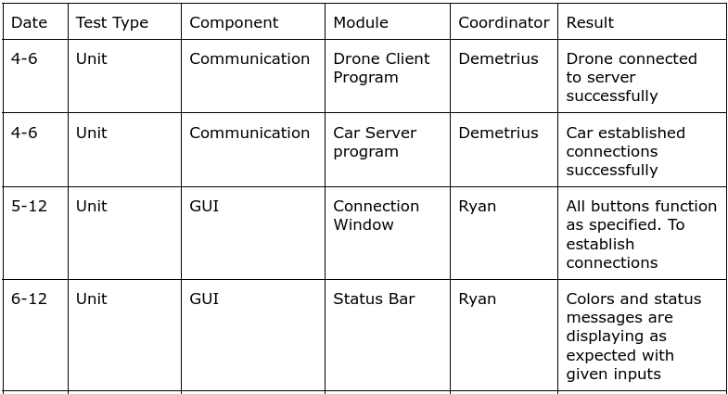
3 Test Procedure: Test Log Example
Notes:
meech

Slide 20
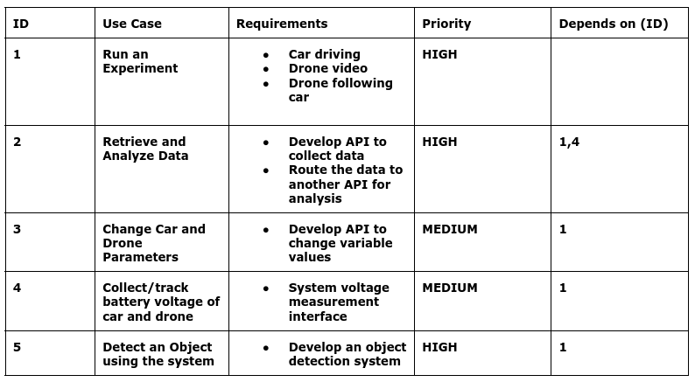
7 Traceability Matrix
Notes:
meech

Slide 21
Contact Us
Demetrius Johnson
meech@umich.edu
Ryan Saur
sauerr@umich.edu
Jonathan Schall
jcschal@umich.edu
Olivia Pellegrini
opelle@umich.edu
Dr. Zheng Song (Client)
zhesong@umich.edu
Dr. Bruce Maxim
Senior Design Professor/Director CIS-4951 Winter 2023
bmaxim@umich.edu

Slide 22
Research References
S. A. Hadiwardoyo, E. Hernández-Orallo, C. T. Calafate, J. -C. Cano and P. Manzoni, "Evaluating UAV-to-Car Communications Performance: Testbed Experiments," 2018 IEEE 32nd International Conference on Advanced Information Networking and Applications (AINA), Krakow, Poland, 2018, pp. 86-92, doi: 10.1109/AINA.2018.00025.
URL: https://ieeexplore.ieee.org/stamp/stamp.jsp?tp=&arnumber=8432227&isnumber=8432202
J. Yoon, I. Kim, W. Chung and D. Kim, "Fast and accurate car detection in drone-view," 2016 IEEE International Conference on Consumer Electronics-Asia (ICCE-Asia), Seoul, Korea (South), 2016, pp. 1-3, doi: 10.1109/ICCE-Asia.2016.7804775.
URL: https://ieeexplore.ieee.org/stamp/stamp.jsp?tp=&arnumber=7804775&isnumber=7804716
Yildiz, Melih, Burcu Bilgiç, Utku Kale, and Dániel Rohács. 2021. "Experimental Investigation of Communication Performance of Drones Used for Autonomous Car Track Tests" Sustainability 13, no. 10: 5602.
URL:
https://doi.org/10.3390/su13105602
Barbeau, Michel, Joaquin Garcia-Alfaro, and Evangelos Kranakis. 2022. "Research Trends in Collaborative Drones" Sensors 22, no. 9: 3321.
URL:
https://doi.org/10.3390/s22093321
Textbook: Software Engineering A PRACTITIONER'S APPROACH EIGHTH EDITION, by Roger S. Pressman, Ph.D. and Bruce R. Maxim, Ph.D.
Notes:
meech

